Slide 1
Introduction to Web & Mobile App Development
Juan-Luis Gorricho

Slide 2
Introduction
Goal: to learn those basic tools for the design and implementation of web applications using HTTP for the client/server communication.
Main topics to work on:
  Classical web applications
  Interactive applications
  Mobile applications

Slide 3


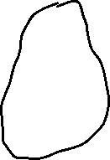


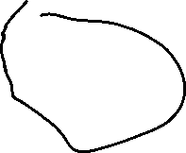


Slide 4
Main topics
Web applications:
  Servlets
  Persistence
  MVC pattern
Interactive applications:
  Polling/pushing options
  Publisher/subscriber pattern
  RESTful web services and WebSockets
Mobile applications:
  User interface
  Communication with a remote server
  Local persistance

Slide 5
Achieved goals
The programming of classical web applications based on the MVC pattern using Servelets and accessing a data base server.
The programming of interactive web applications based on the Publisher/Subscriber pattern using RESTful web services and WebSockets.
The programming of mobile applications with the Android platform.

